Slide 1
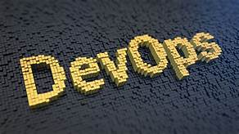
AWS (AMAZON WEBSERVICES)
Submitted By:-
ABHISHEK KUMAR
Roll no:-15110128
C.S.E.(2K15) 2 MONTHS SOFTWARE TRAINING

Slide 2
OVERVIEW
DEVOPS
DevOps (a clipped compound of “development” and “operations” ) is a software development methodology that combines software development (Dev) with information technology operations (Ops). The goal of DevOps is shorten the system development life cycle while delivering features, fixes, and updates frequently in close alignment with business objectives.
DEV : CREATE, PLAN, PACKAGE, VERIFY
OPS : RELEASE, CONFIGURE, MONITOR

Slide 3
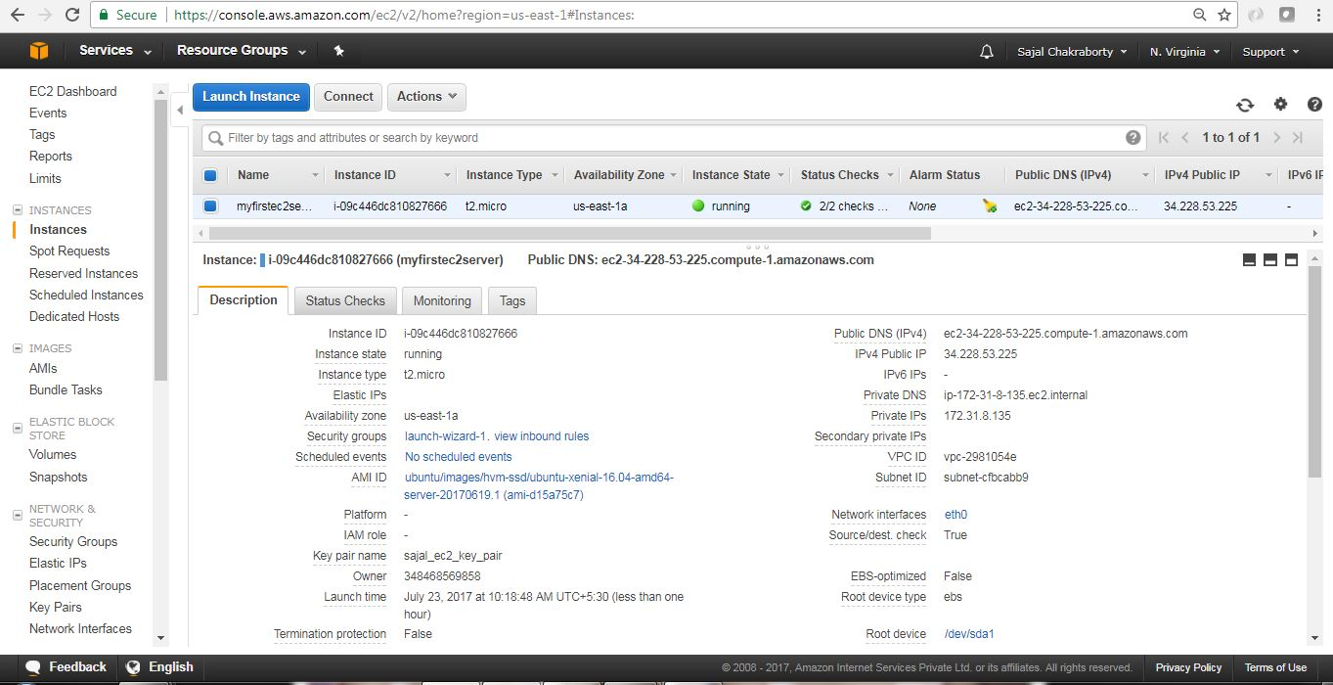
AUTOMATION OF A WEBSITE THROUGH JENKINS STEPS :
1. Launch a EC2 instance and connect it through putty or virtual machine.

Slide 4
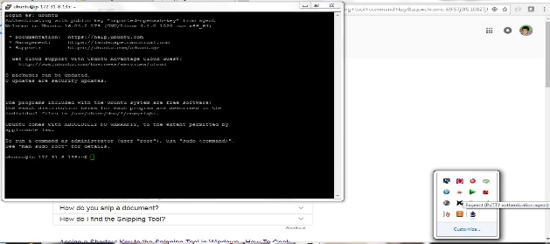
This is the screenshot of connected EC2 instance through Putty

Slide 5
2. Install Apache in ubuntu.
Command – sudo apt-get update
Sudo apt-get install apache
3. Install Jenkins in ubuntu.
Command – sudo apt-get update
wget -q -O - https://pkg.jenkins.io/debian/jenkins-
ci.org.key | sudo apt-key add –
sudo sh -c 'echo deb http://pkg.jenkins.io/debian-stable
binary/etc/apt/sources.list.d/jenkins.list'
sudo apt-get update
sudo apt-get install Jenkins

Slide 6
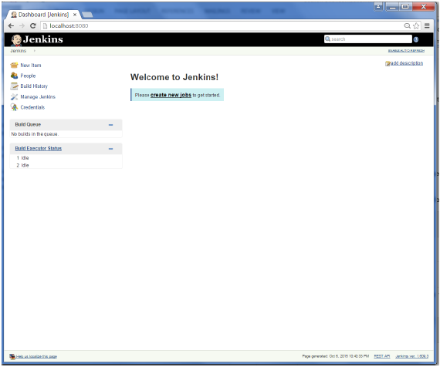
4. Connect Jenkins by entering public ip : 8080 in internet explorer.

Slide 7
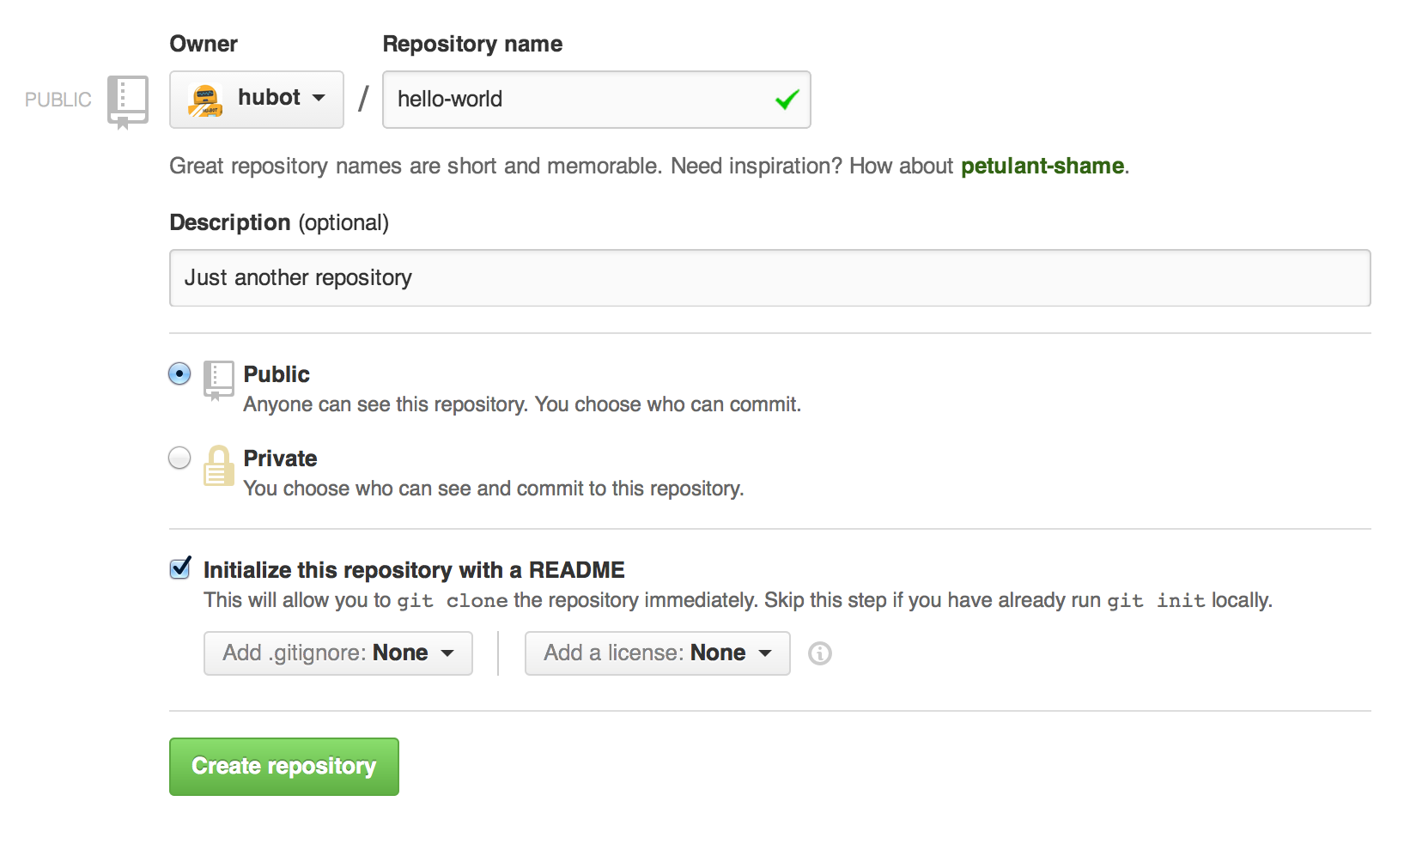
5. Make a directory in local of any name.
6. Make a repository of any name in github.

Slide 8
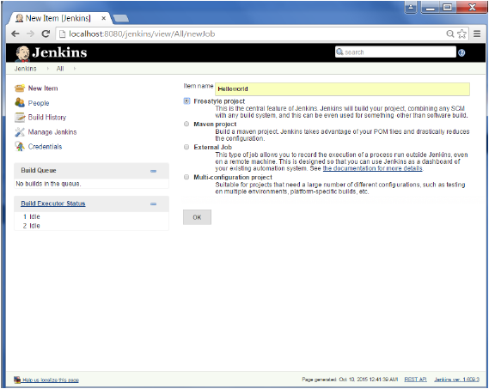
7. Make a job in Jenkins of any name.

Slide 9
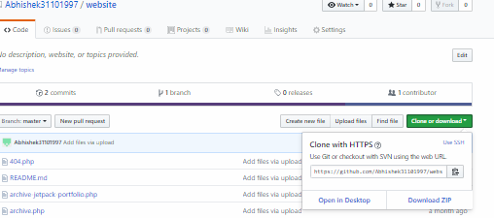
8. Clone your repository from github by using
Command – git clone <url of your repository from github>

Slide 10
9. Change your directory to repository directory and download a static website
here by using
Command – sudo wget <link address of static template>
10. Unzip your template file by using
Command – sudo unzip <file name>
11. If not working then Install unzip in your local by using
Command – sudo apt-get update
Sudo apt-get install unzip
12. Use command – git add .

Slide 11
13. Then use command – git status (you will found the color of all files are
green and ready to commit)
14. Use command – git commit -m “message which you want”
15. Use command – git push (it will ask you your username and password of github one by one)

Slide 12
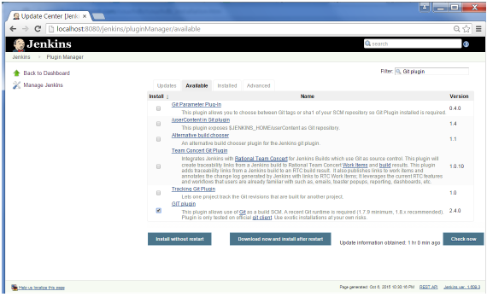
16. Install “Github” plugin from manage plugin in Jenkins.
17. Go to configure part of Jenkins and source code management part.

Slide 13
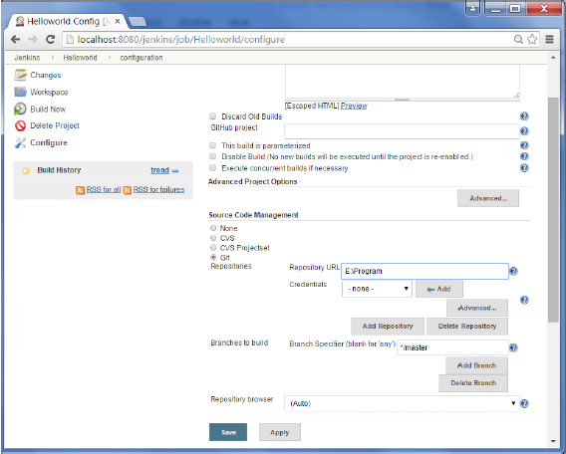
18. Now copy the url of your repository from github and paste the url in source code management section.

Slide 14
18. Now give some commands in build_Add build step_execute Shell
Command - #! /bin/bash
cp -R /var/lib/jenkins/workspace/viva /var/www/html
exit
20. Save
21. Use build now option and your build will be successful in console output.
22. Open a new tab in internet explorer by typing
public_ip/repository_name

Slide 15
Thanks

